Slide 1

Unlock with Your Heart: Heartbeat-based Authentication on Commercial Mobile Phones
Lei Wang, Kang Wang, Ke Sun, Wei Wang, Chen Tian, Lei Xie, Qing Gu
Presenter: Dr. Lei Xie
State Key Laboratory for Novel Software Technology
Nanjing University
UBICOMP2018 Oct ^{10th}, 2018
Notes:
Good afternoon everyone.

Slide 2

Motivation
Unlock your mobile device: authentication system to identify the user

Slide 3
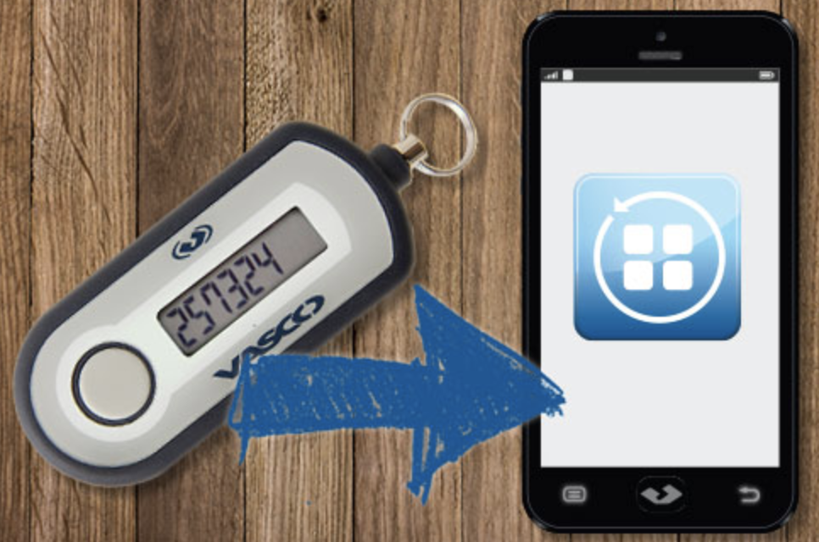

Motivation
Traditional metrics: token&password
Easy to leakage and lost!

Slide 4



Motivation
Biometric features: fingerprint, face, and voices.
Vulnerable to spoofing and replaying!

Slide 5

Motivation
Another biometric feature: vibration of chest in response to heartbeat(i.e.,SCG)
Unique for each person
Against spoofing
Linked to “liveness”

Slide 6
Can we enable the heartbeat-based authentication system on the commercial mobile devices?

Slide 7


Slide 8
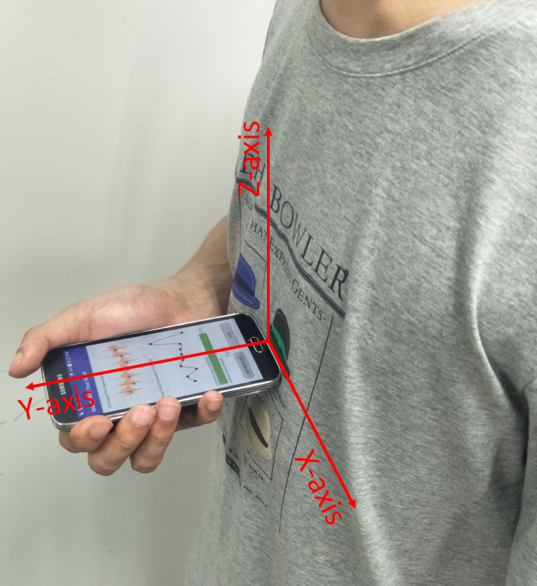
Basic idea
We utilizes the built-in accelerometer to capture the heartbeat vibration and perform user authentication.

Slide 9
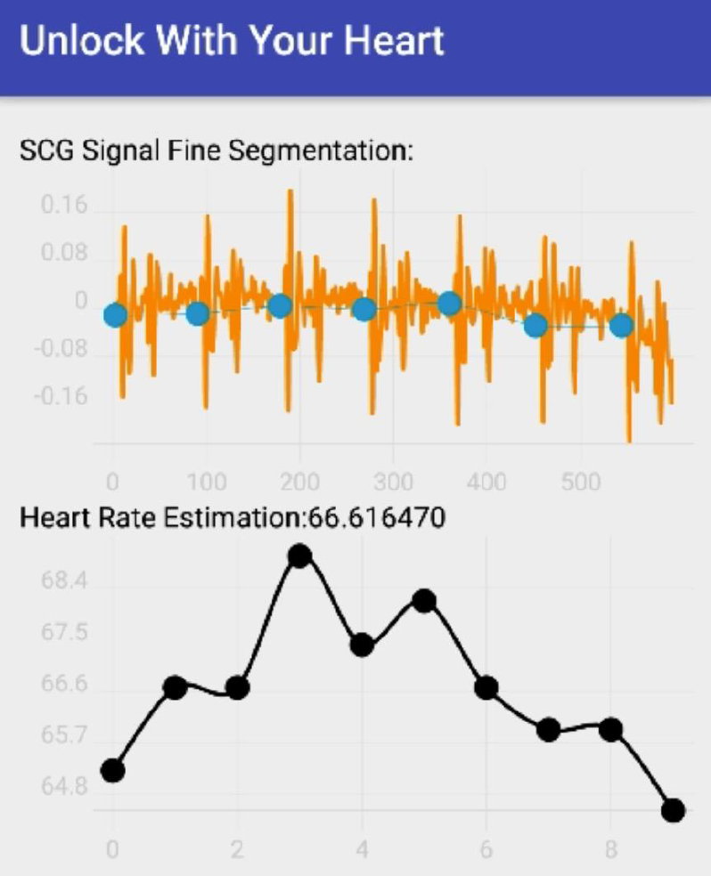



Challenges
Human heartbeat patterns contain intrinsic Heart Rate Variability (HRV)
Reliable features with different durations should be extracted
Human heartbeat patterns change under various conditions

Slide 10
Challenge 1
How to segment heart duration with
the effect of the variability of heart rate?

Slide 11
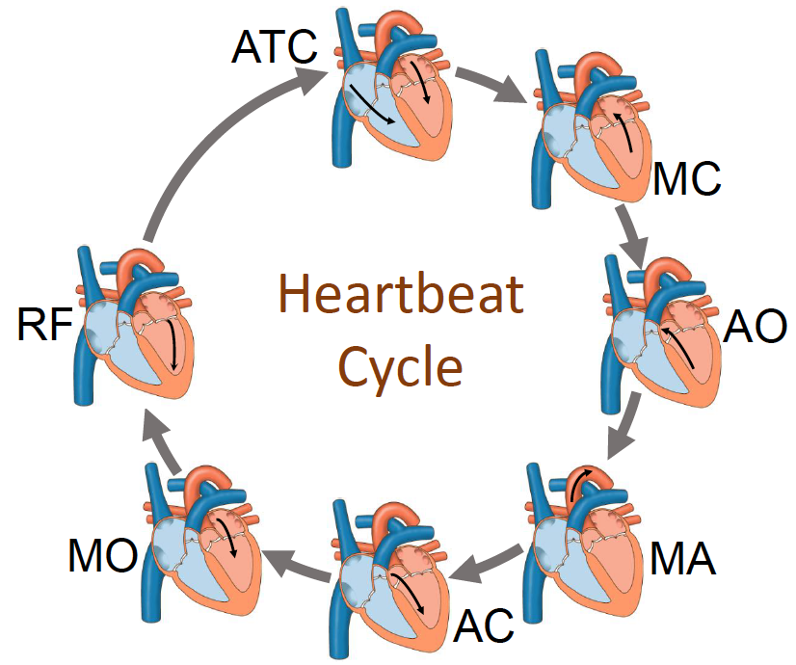
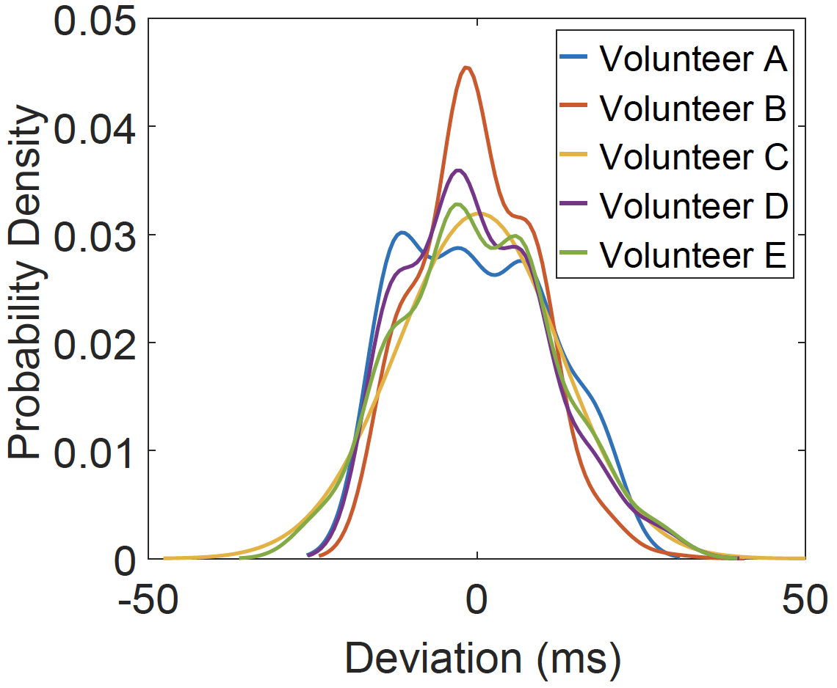
Basic idea
Although heart rate has intrinsic variability, the interval between AO and RF is stable.
Segment the heartbeat based on the stable interval between AO and RF
Heartbeat cycle
Deviation of AO and RF from mean value

Slide 12
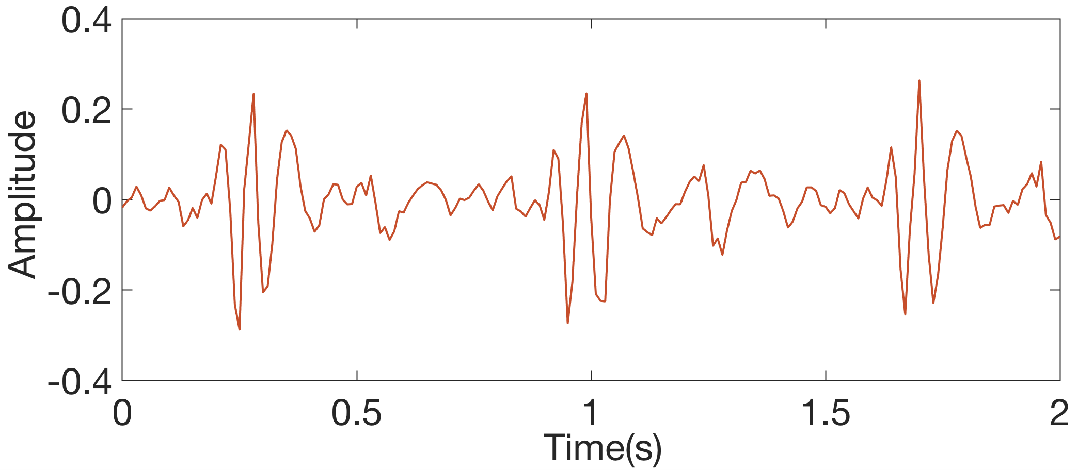
Step1: Derive the coarse template
Sort the local maximum points by their amplitudes
Perform a pruning algorithm to remove noisy peaks
Choose the AO and RF points
Generate the Coarse template
1
3
2
7
4
9
6
8
5
11
10
14
12
13
15

Slide 13
Step1: Derive the coarse template
Sort the local maximum points by their amplitudes
Perform a pruning algorithm to remove noisy peaks
Choose the AO and RF points
Generate the Coarse template
1
3
2
7
4
9
6
8
5
11
10
14
12
13
15

Slide 14
Step1: Derive the coarse template
Sort the local maximum points by their amplitudes
Perform a pruning algorithm to remove noisy peaks
Choose the AO and RF points
Generate the Coarse template
1
3
2
7
4
9
6
8
5
11
10
14
12
13
15

Slide 15
Step1: Derive the coarse template
Sort the local maximum points by their amplitudes
Perform a pruning algorithm to remove noisy peaks
Choose the AO and RF points
Generate the Coarse template
1
3
2
7
4
9
6
8
5
11
10
14
12
13
15

Slide 16
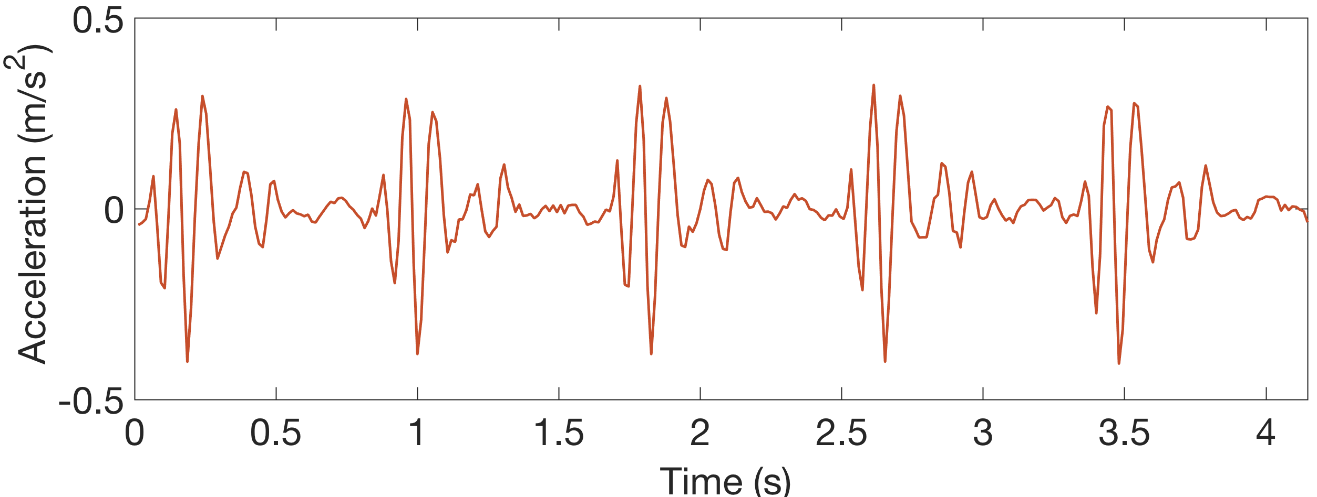
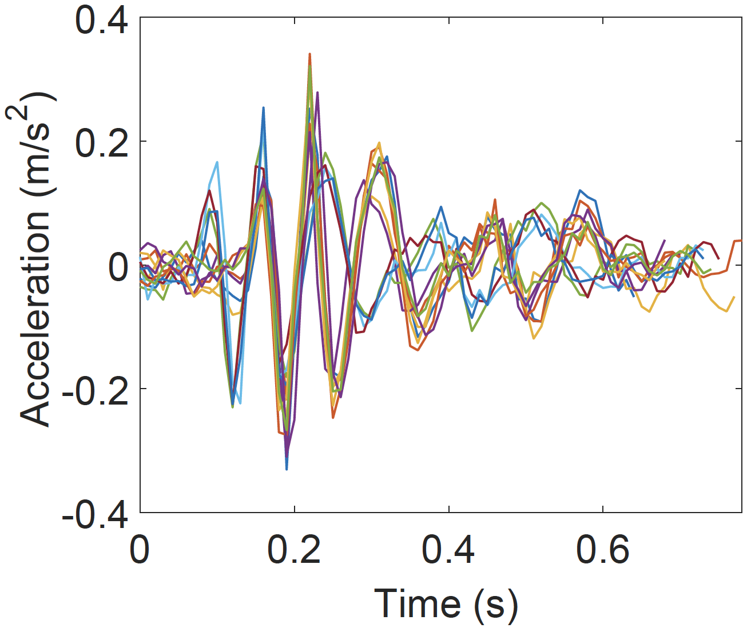

Step2: Coarse alignment
Cross-correlation between coarse-template with SCG signals

Slide 17
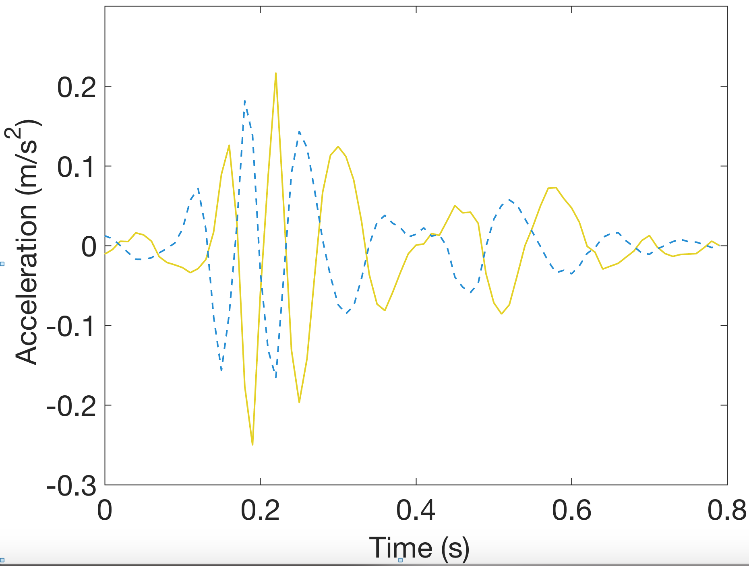
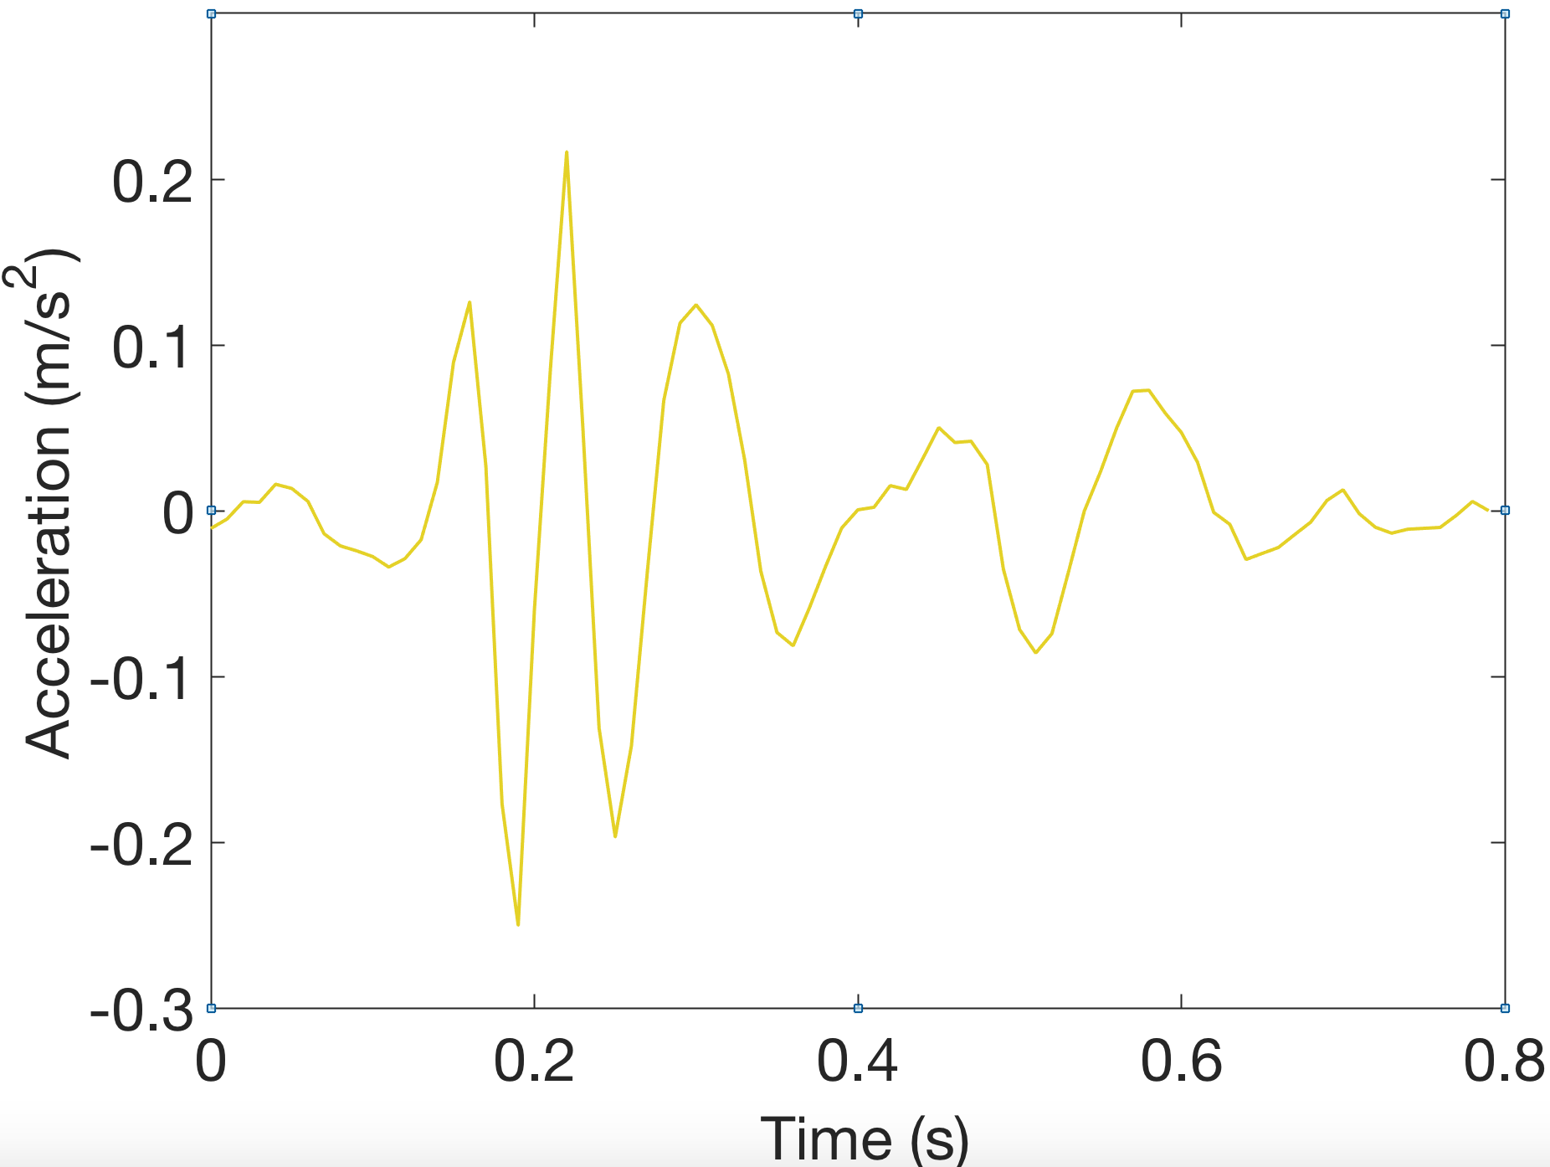
Step3: Derive the fine template
Average over all heartbeat cycles to smooth the signal
Normalize the smoothed signal and estimate the first derivative
Generate the Coarse template
1

Slide 18
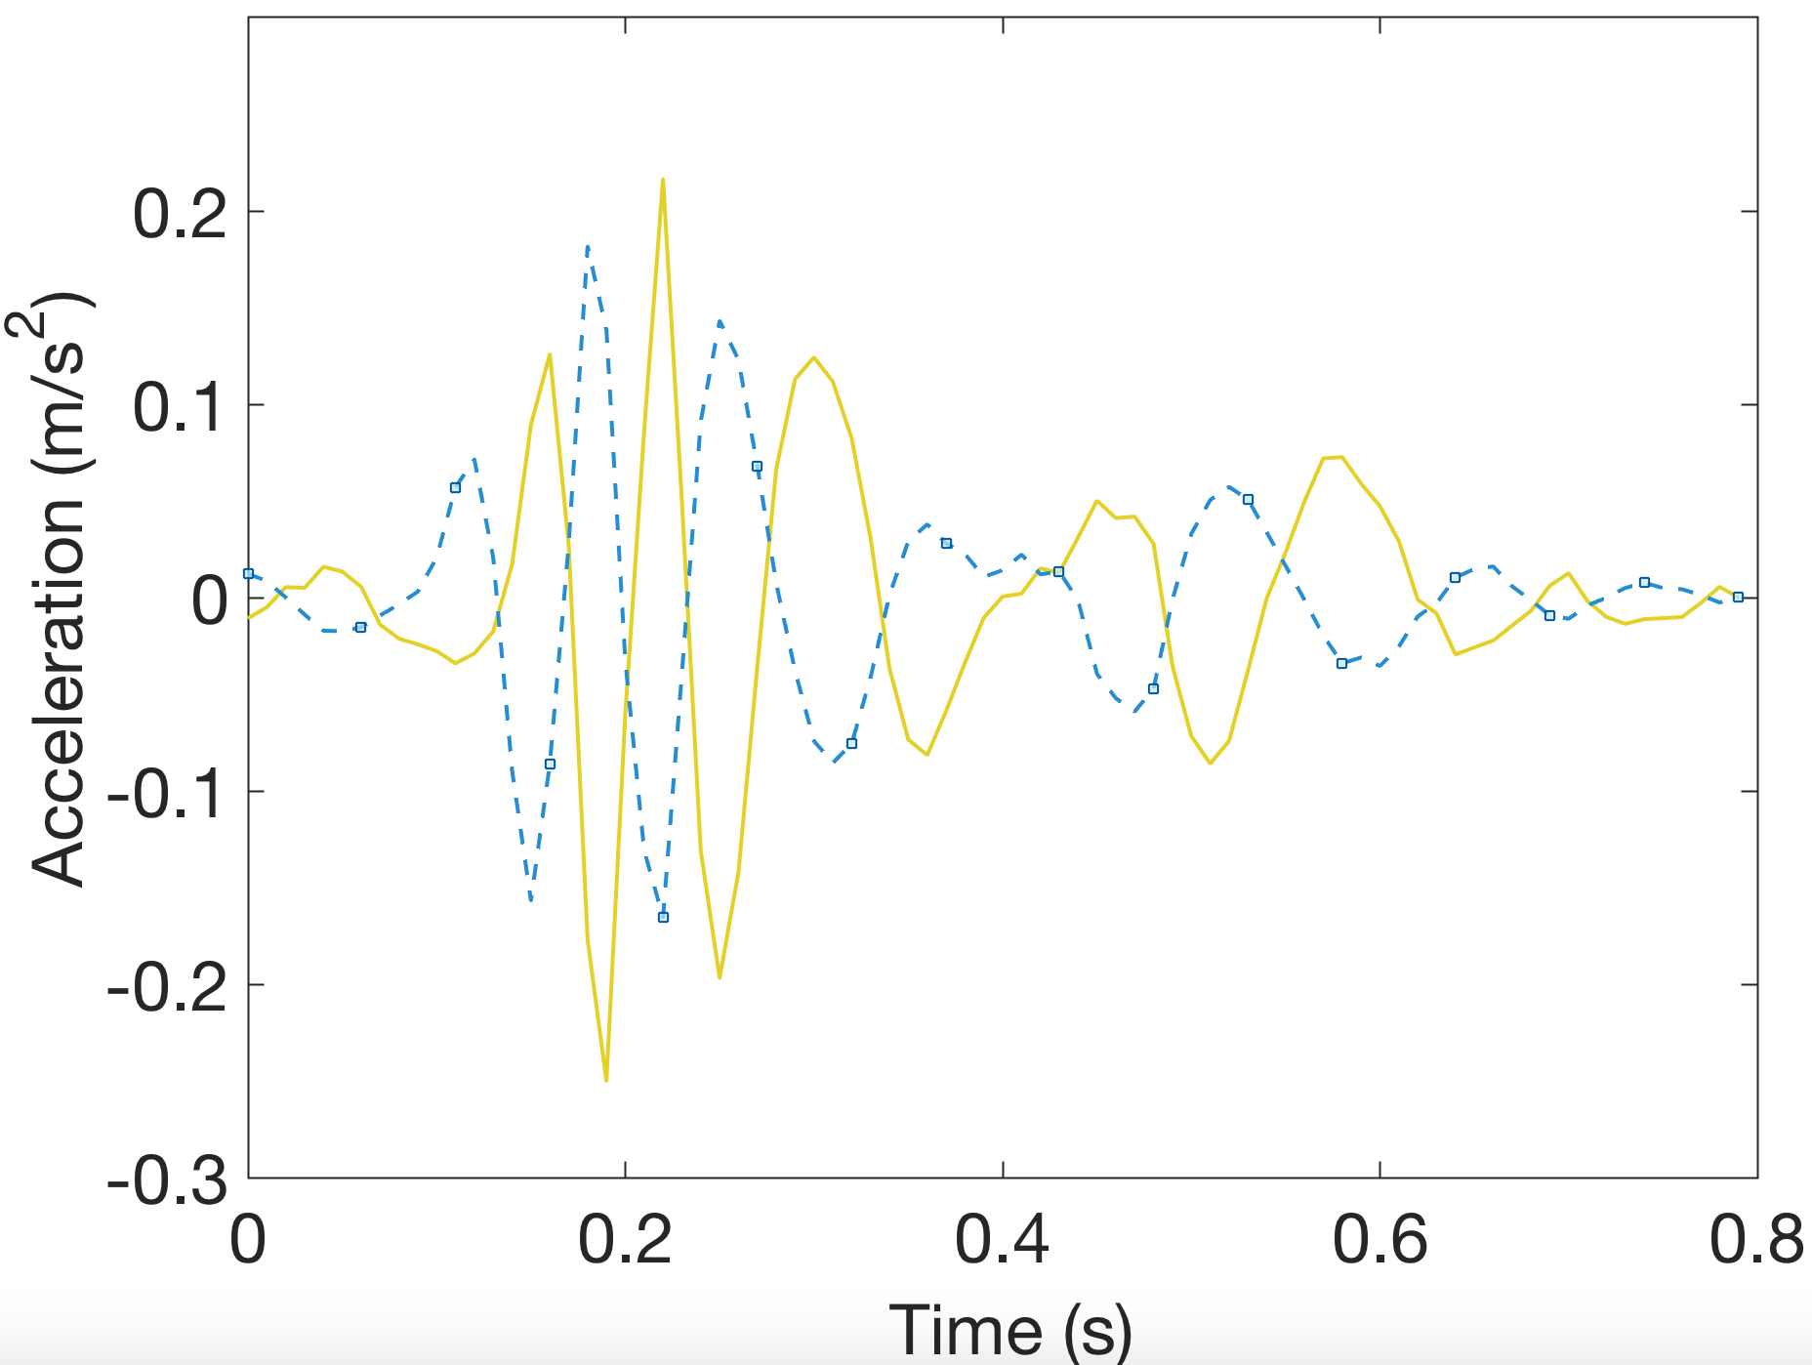
Step3: Derive the fine template
Average over all heartbeat cycles to smooth the signal
Normalize the smoothed signal and estimate the first derivative
Generate the Coarse template
1

Slide 19
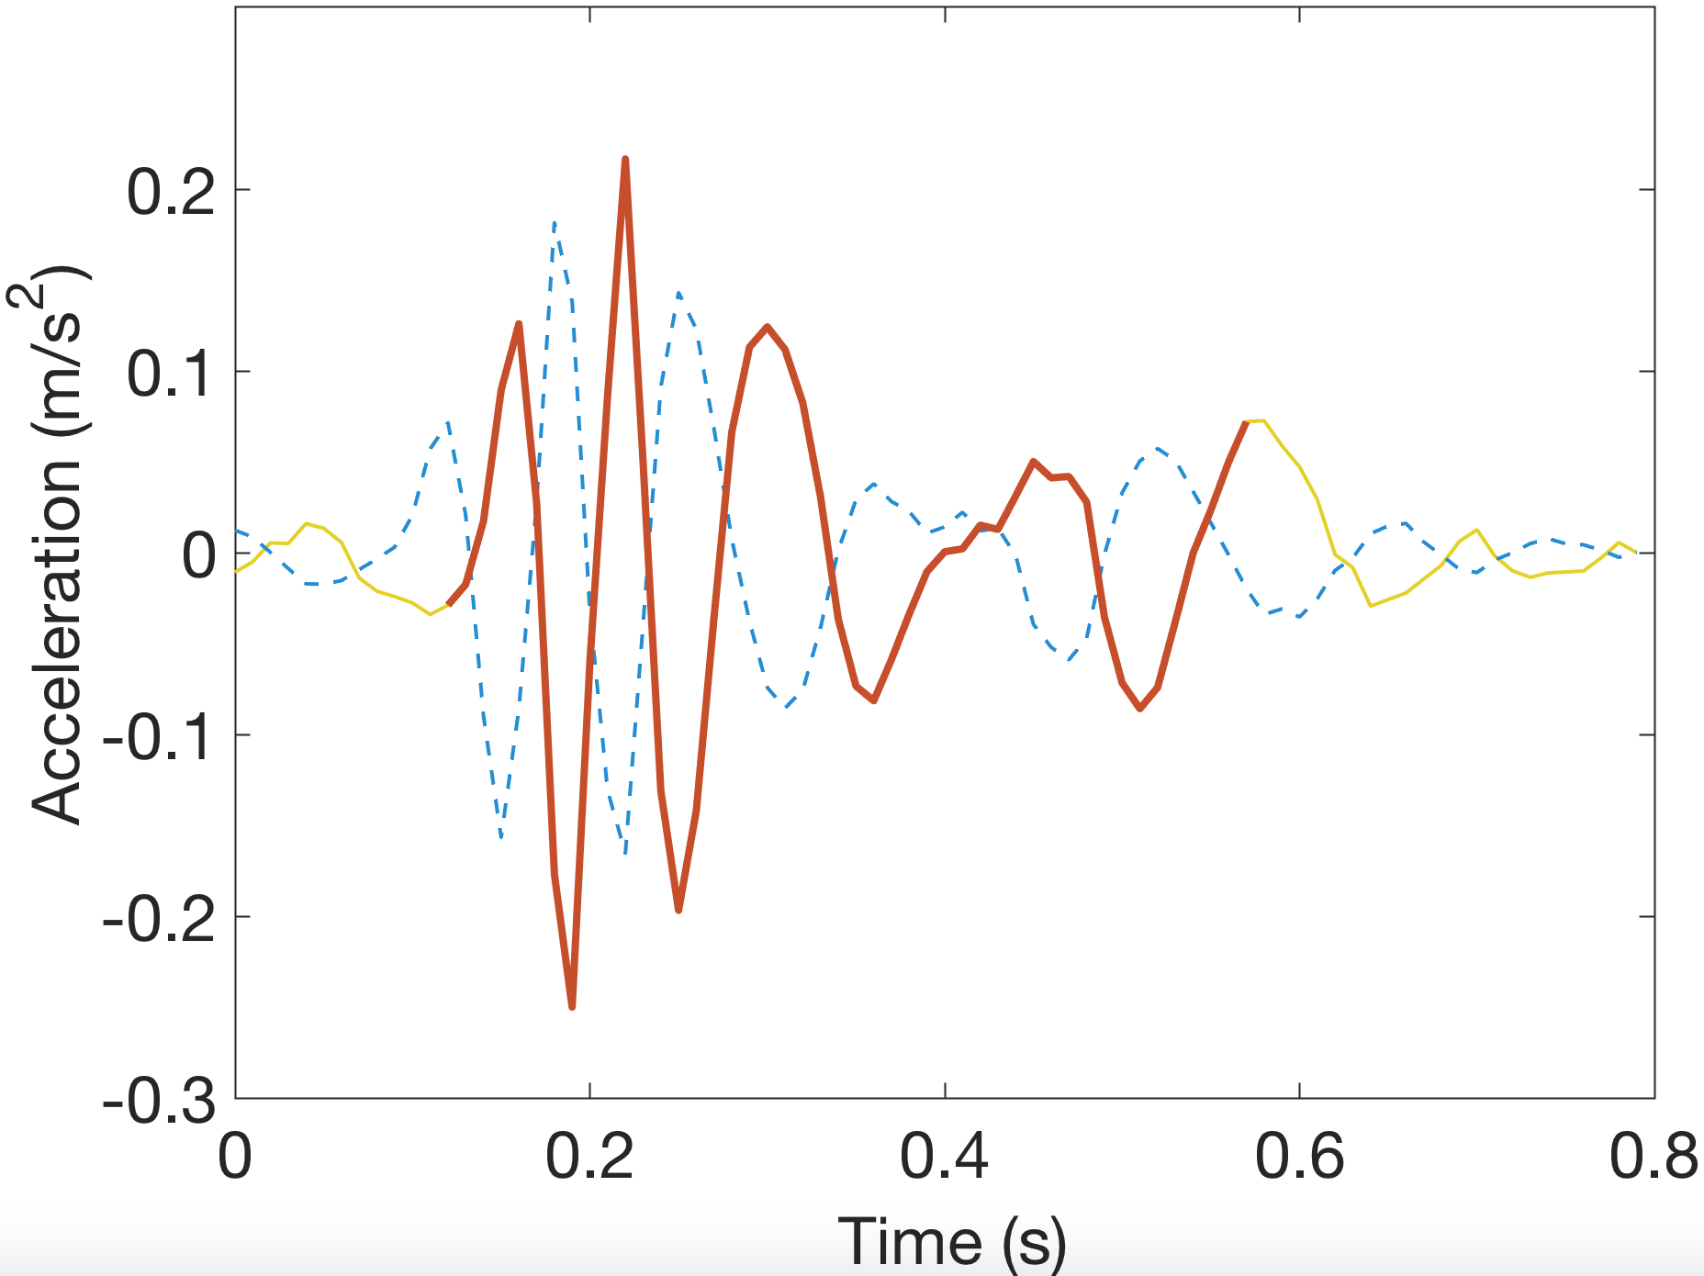
Step3: Derive the fine template
Average over all heartbeat cycles to smooth the signal
Normalize the smoothed signal and estimate the first derivative
Generate the Coarse template
1

Slide 20
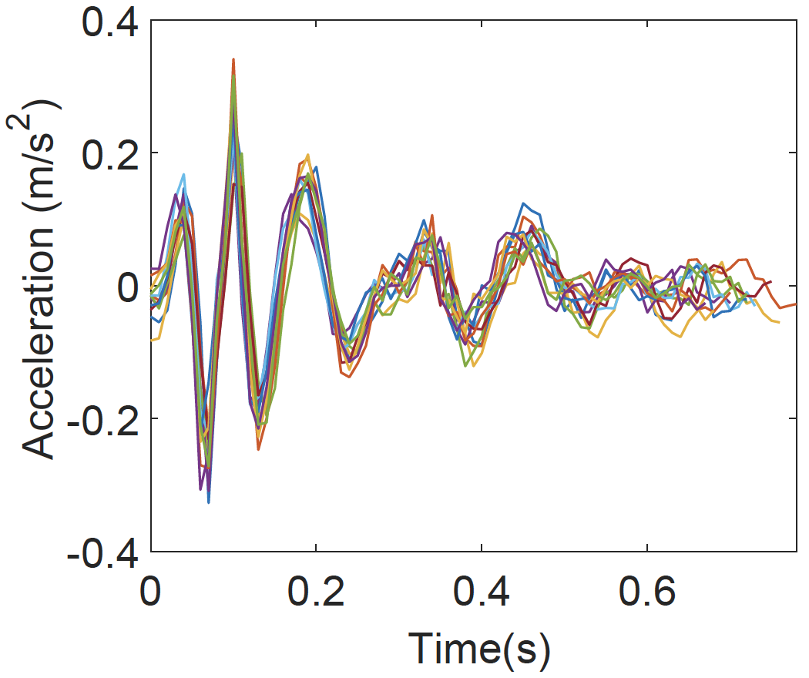

Step4: Fine alignment
Cross-correlation between fine-template with SCG signals

Slide 21
Challenge 2
What reliable features with different durations can be selected?

Slide 22
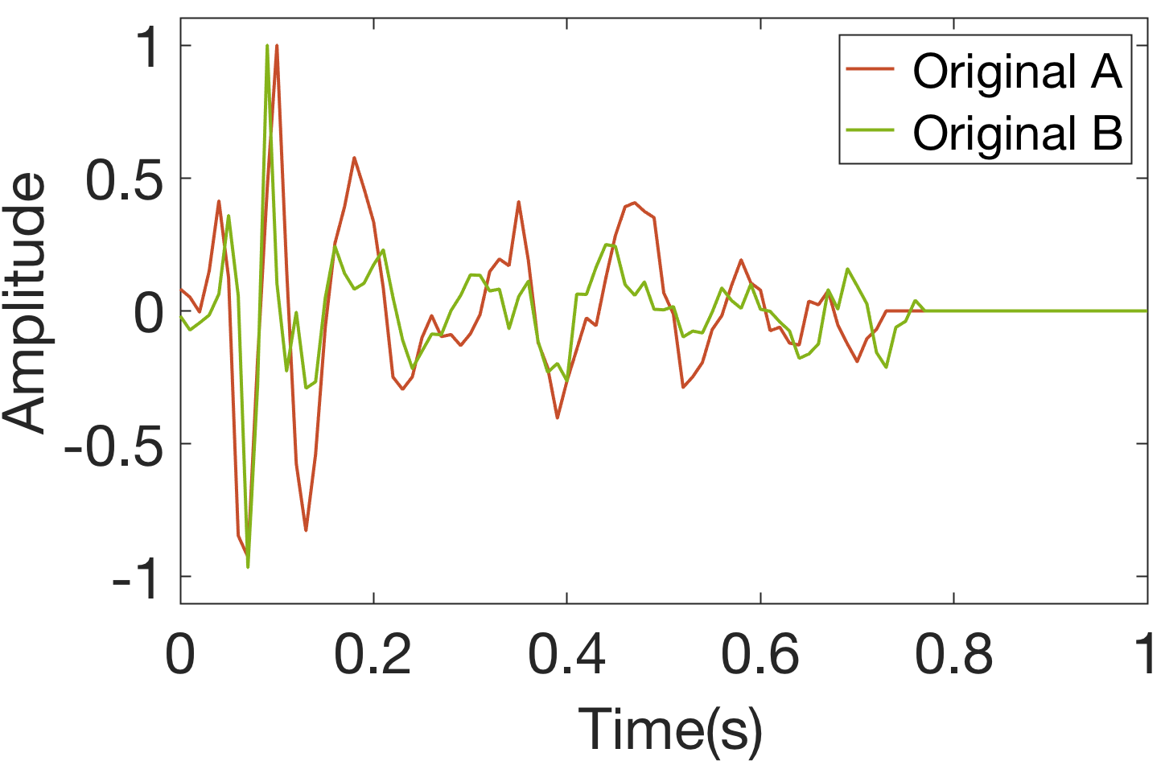
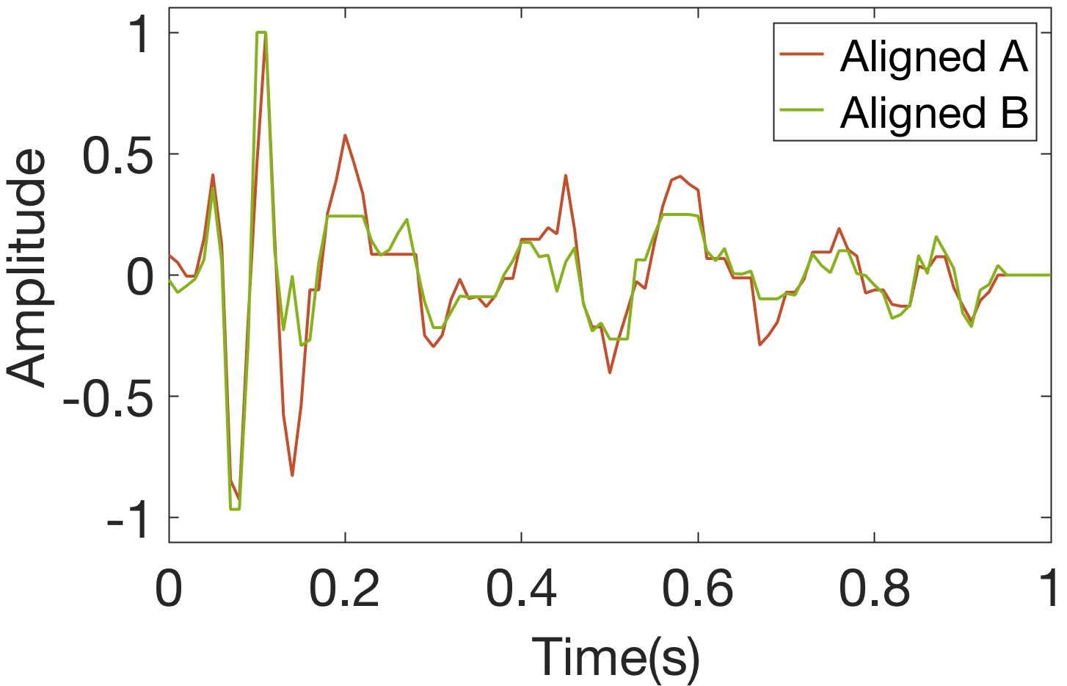
Traditional solution
Dynamic Time Warping (DTW):
Ignores the timing difference in heartbeat motion stages

Slide 23
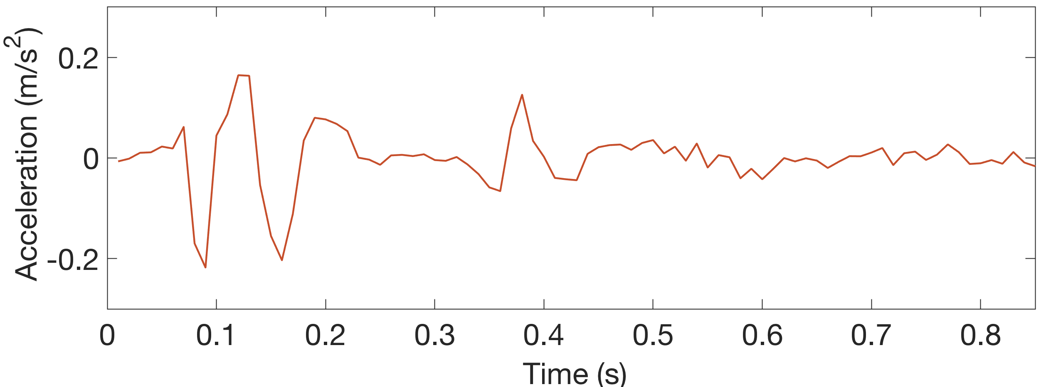
Traditional solution
Raw time sequence:
Noises reduce the reliability of the raw SCG sequence

Slide 24
Basic idea
Discrete Wavelet Transform(DWT) can separate the original signals into multiple levels in different frequency ranges

Slide 25
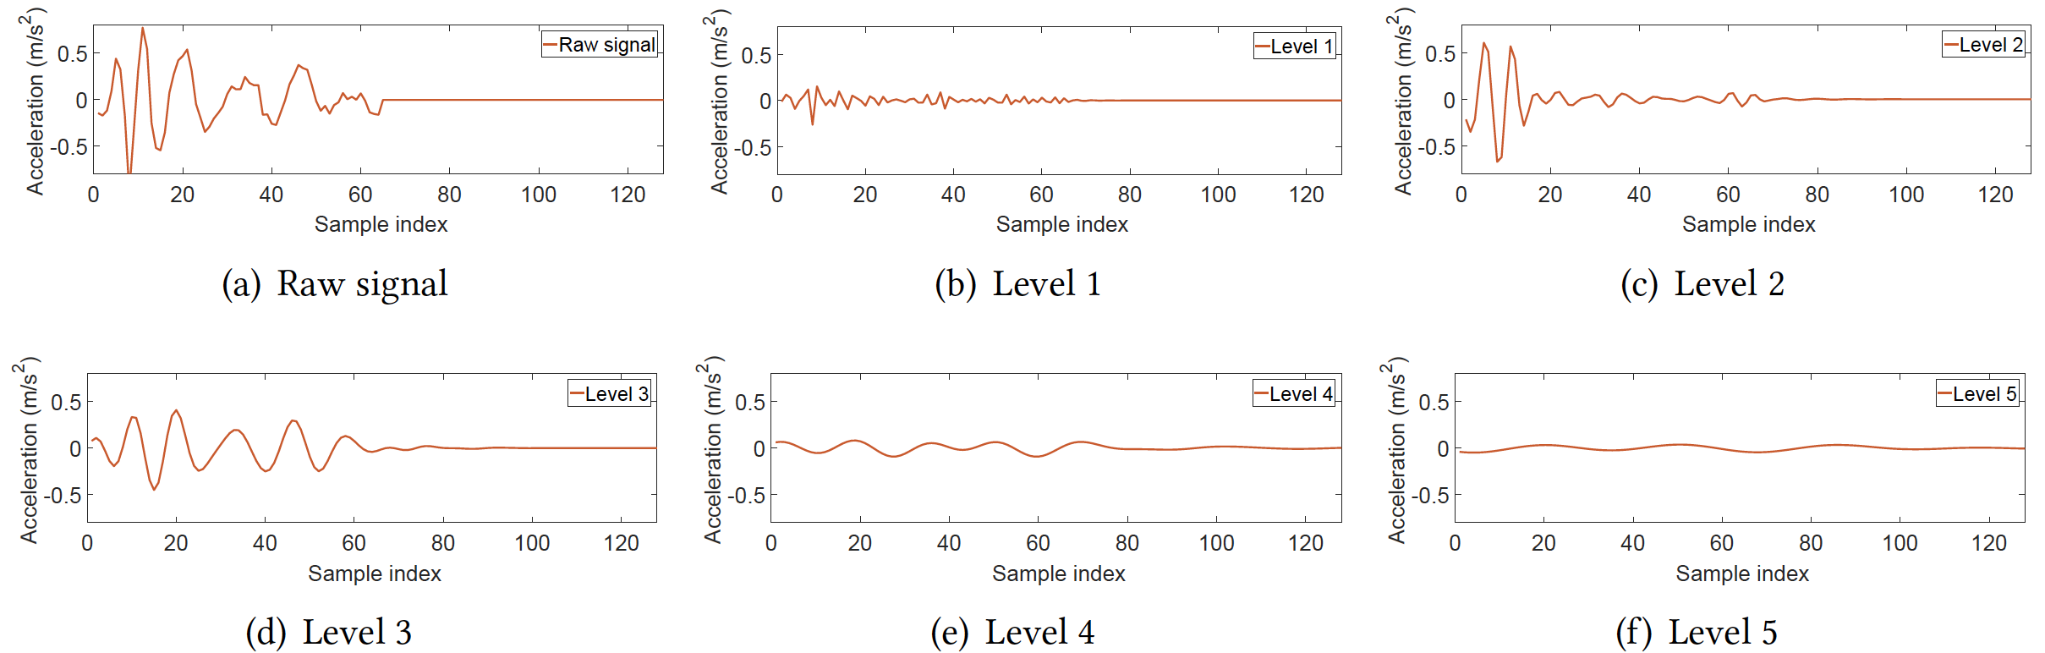
DWT
Noise
×
Noise

Slide 26
Challenge 3
How to make system robust with human heartbeat patterns change?

Slide 27
Heartbeat pattern selection
For heart rate
50-80
BPM
80-100 BPM
100-120 BPM

Slide 28

Heartbeat pattern selection
For posture
0.86g ∼ g
0.5g ∼ 0.86g
0g ∼ 0.5g

Slide 29
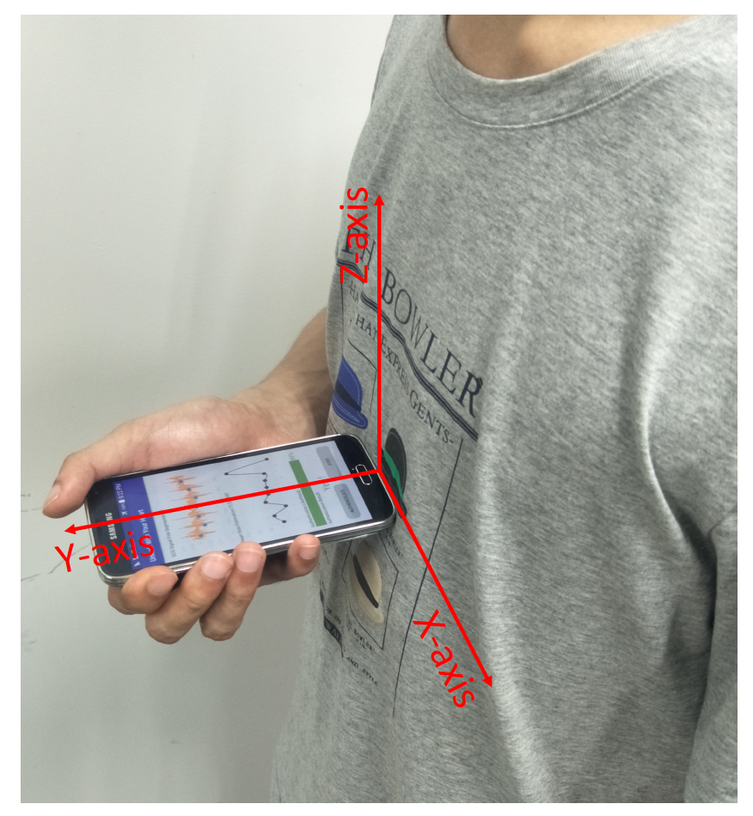
Implementation
Implemented on:
Samsung Glaxy S5 and S7 with Android
Nexus 6P with Android
LIBSVM tool in Java
Prameters use:
100Hz sampling rate

Slide 30
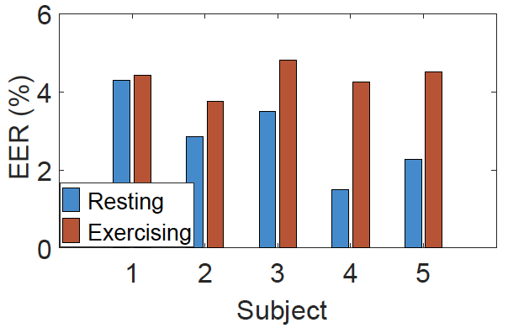
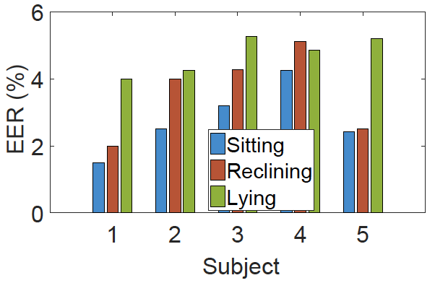
Evaluation
Our system achieves comparable performance under different scenarios

Slide 31
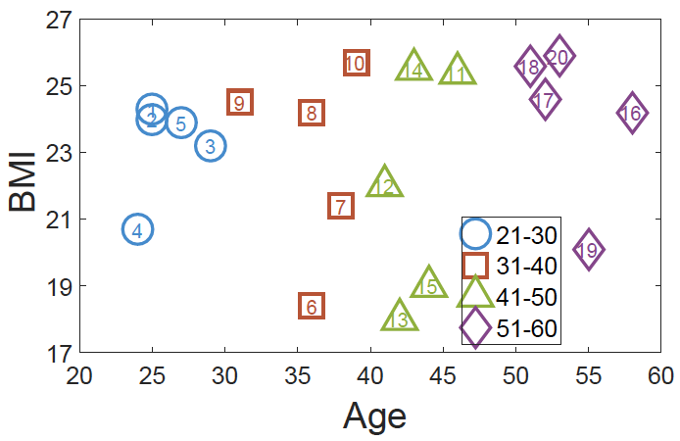
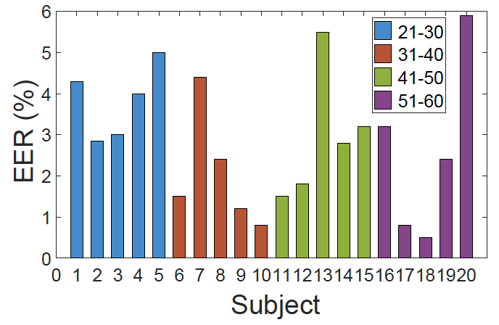
Evaluation
Our system is robust over various ages and somatotypes.

Slide 32
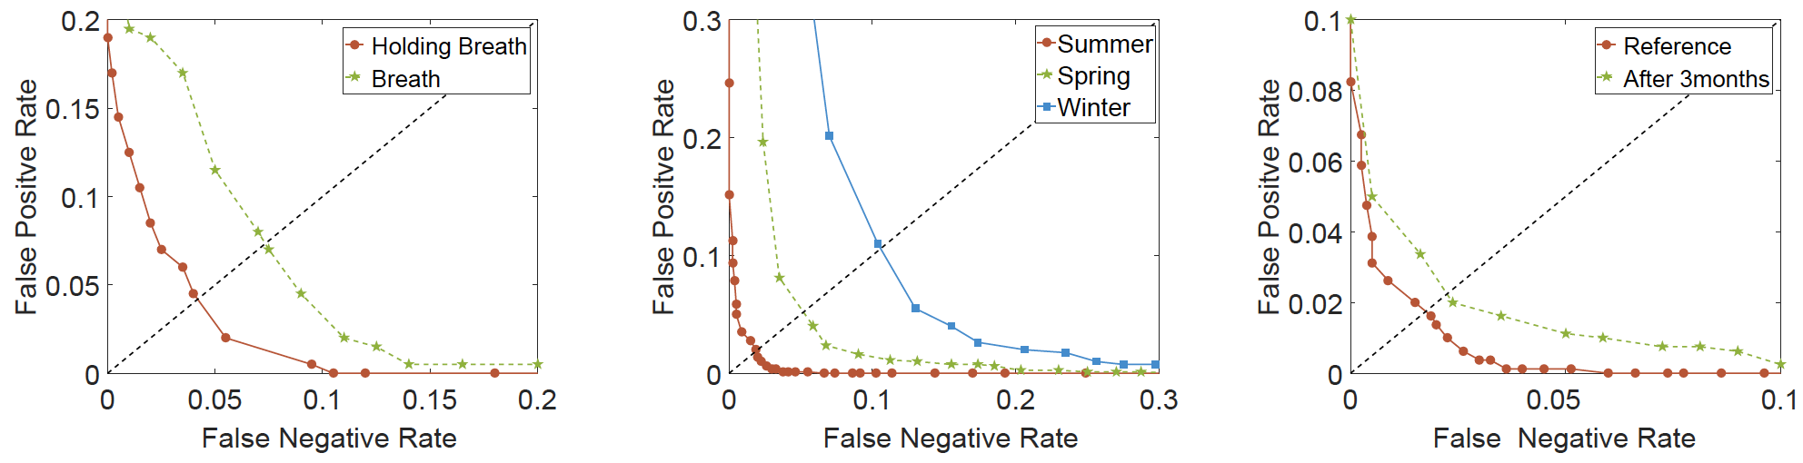
Evaluation
Our system is robust against the interferences from human respiration.
Our system is robust over different types of clothes.
Heartbeat patterns are stable over a long period.

Slide 33
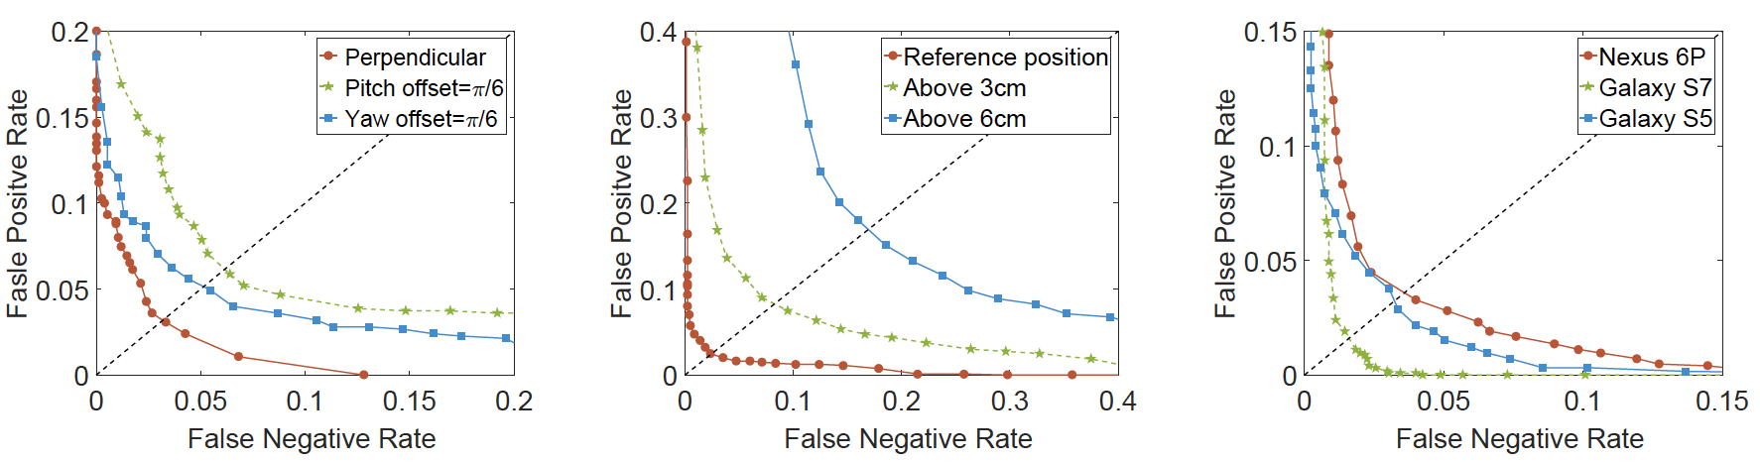
Evaluation
The EER degrades lowly when the angle of the mobile phone is changed by less than 30 degrees.
Our system can tolerate position deviations as large as 3 cm from the standard testing point.
Our system is effective for different types of mobile phones.

Slide 34
Conclusion
To our best knowledge, we are the first to perform heartbeat-based user authentication using the built-in accelerometer on commercial mobile phones.
We propose a set of novel signal processing schemes designed for heartbeat-based user authentication.
We implement our authentication system on commercial smartphones.

Slide 35
Thank you
Q&A

